Slide 1
Project 1: Gender Stats
Joseph Spencer

Slide 2
Q1 Female Educational Attainment Under 30%
For this question I am charting countries where the percentage of females who complete post secondary education is less than 30%
Mapper creates key value pairs for each value in a line which contains the words "Educational attainment, at least completed upper secondary, population 25+, female (%)"
Reducer combines these key value pairs but only writes when the combined value is less than 30

Slide 3
Q2 Average Increase in Education
For this question I calculated the annual yearly increase in female Educational attainment at least postsecondary where country name matched United States
My mapper creates a key value pair for each year following 2000
My reducer finds the difference between each subsequent year and averages them
Only one key value pair is output and that is “United States 1.4320654”
So the average yearly increase in female educational attainment from the year 2000 was 1.43% according to my computation

Slide 4
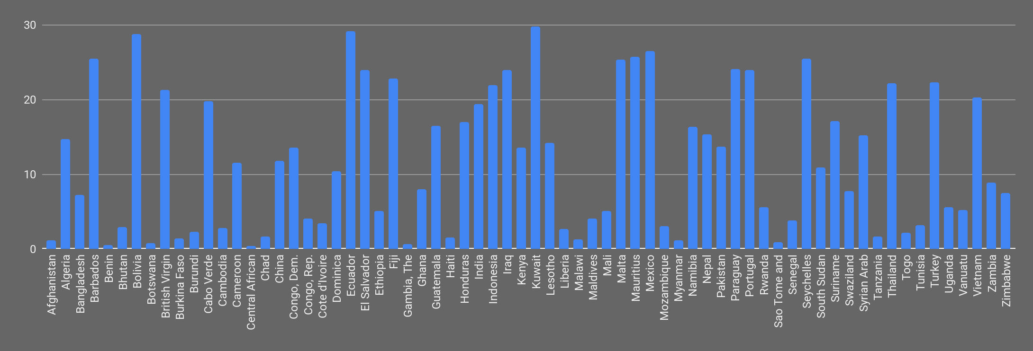
Q1

Slide 5
Q3Q4 Percent Increase in Employment Male/Female
For these question I tried to calculate the percent change in male and female employment from the year 2000 onward for all countries and regions
For Q3 the mapper creates key value pairs for every value in a line that contains the words "Employment to population ratio, 15+, male" and year is greater than 2000
Q4 is similar but changes the word male to female
The reducers for these questions subtract the earliest year from the most recent to report percent change

Slide 6
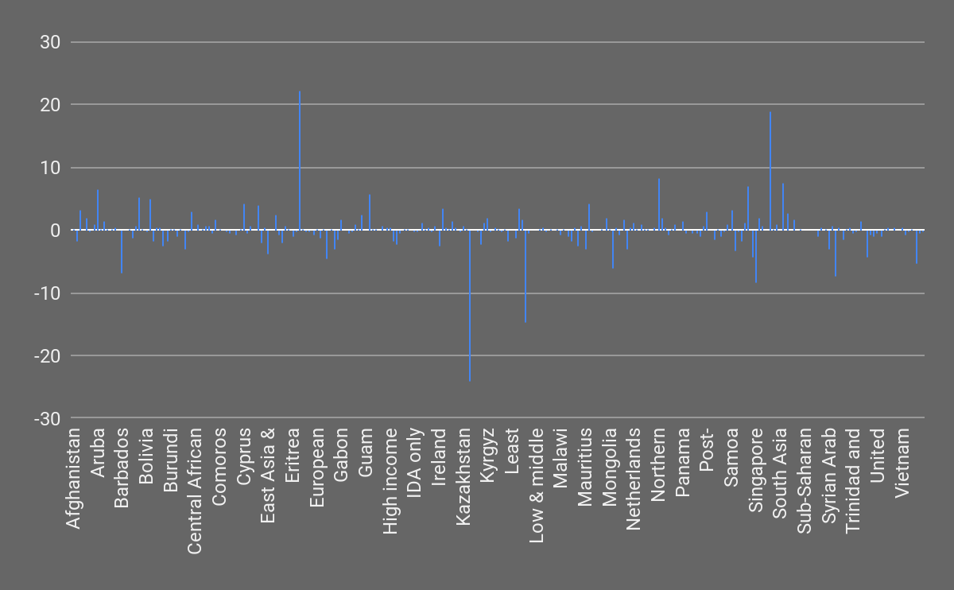
Q3 Percent Increase in Male Employment

Slide 7
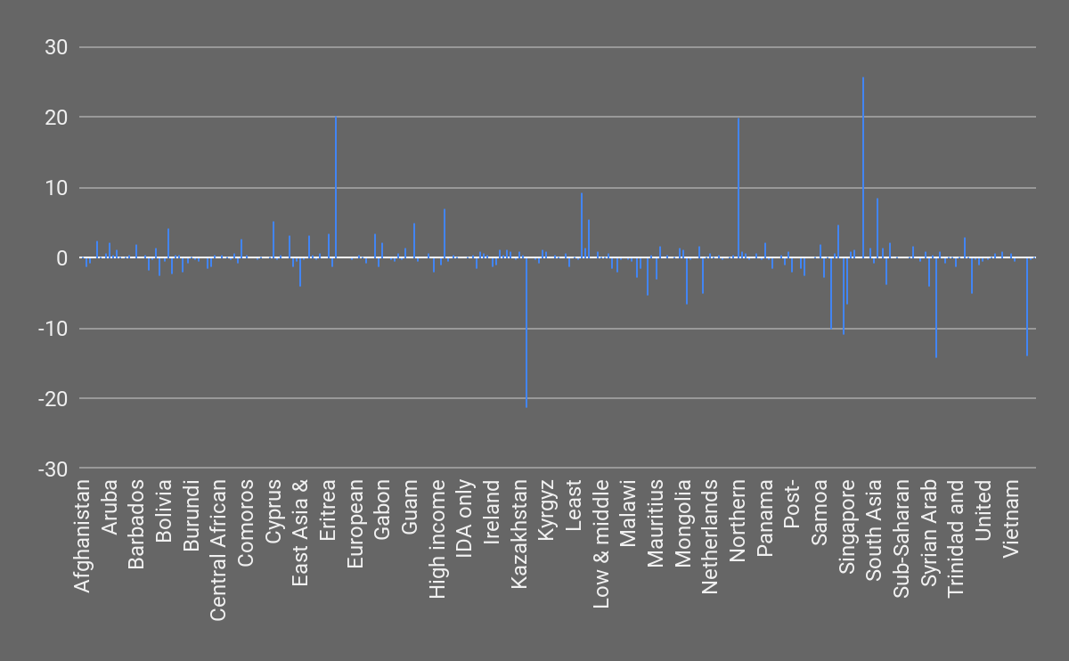
Q4 Percent Increase in Female Employment

Slide 8
Q5 Countries with the most female firm ownership
I decided it would be interesting to try to find countries where a high percentage of firms have female participation in ownership
To do this I made a mapper to create key value pairs for every value in a line containing the words "Firms with female participation in ownership"
The reducer combines these key value pairs and only writes the key value pairs with a value greater than 50%
The results seriously surprised me as most of the countries I expected to show a high rate of female firm ownership didn’t appear in the results

Slide 9
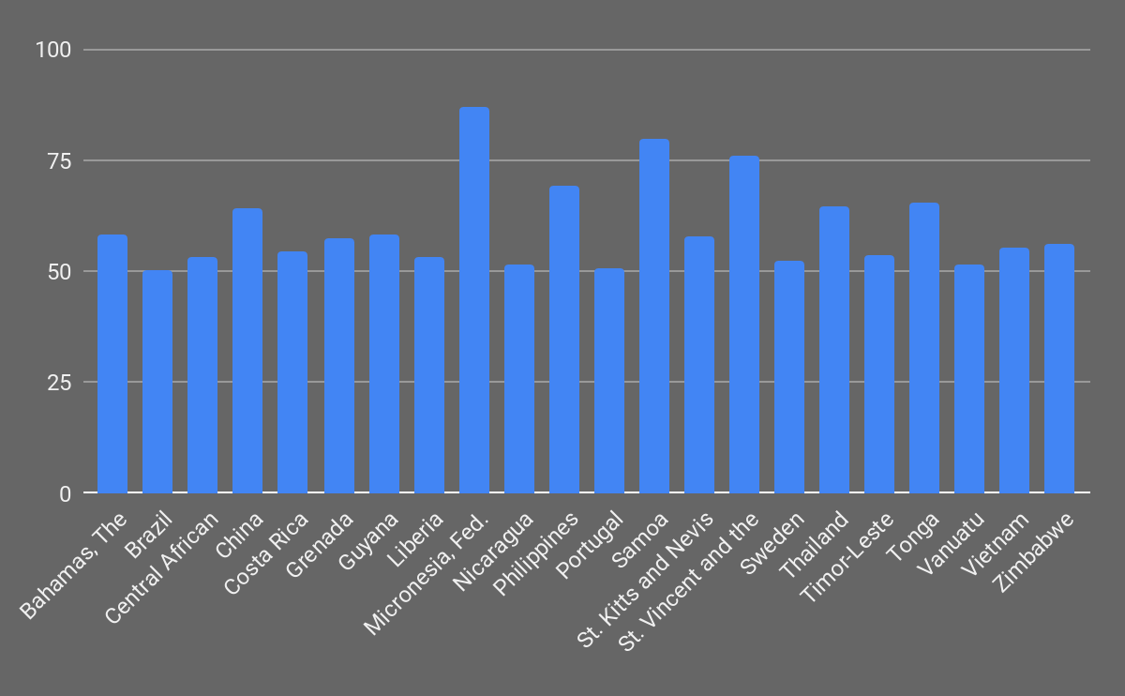
Q5 Countries with the most female firm ownership

